Slide 1
Creative Writing Welcome to the Workhouse

Slide 2
Teacher Instruction
Students to use listening grid and to fill in following lecture style delivery of key info and discussions using Rosen’s Questioning Matrix.
Students to fill in third column – creative sentences around topics.
Students to read extracts from Workhouse Voices Letter collection. Take time to explain what an archive is and demonstrate how to find the National Archive Workhouse Voices page online.
Students to make up titles for the letters – what would they be called if they were from a story.
Students to answer questions about their chosen idea and then to write silently (free write).

Slide 3
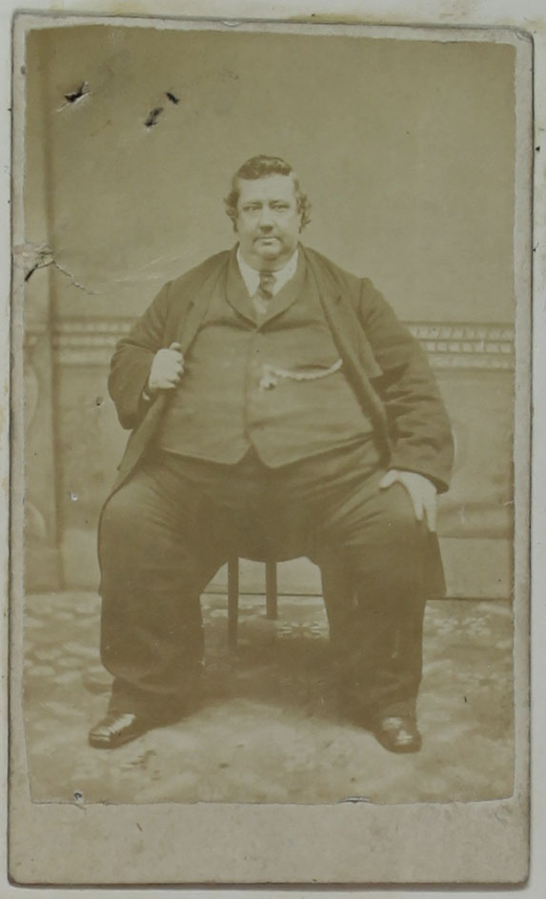
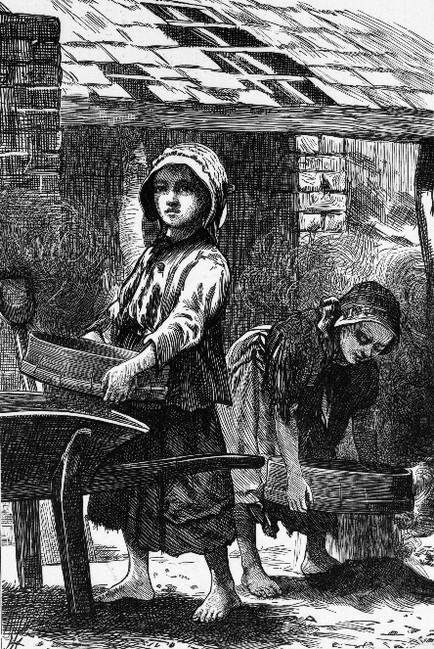
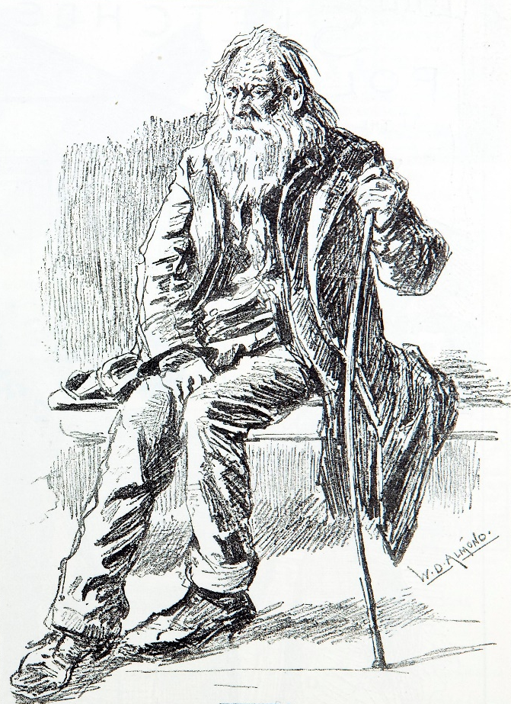
What are we looking for?
Realistic characters
Good background detail on the workhouse system to make your story believable
A sense of location
Interesting language, description and dialogue which reflects the time.
Use of the Workhouse Voices letters as inspiration.
400-450 Words.

Slide 4
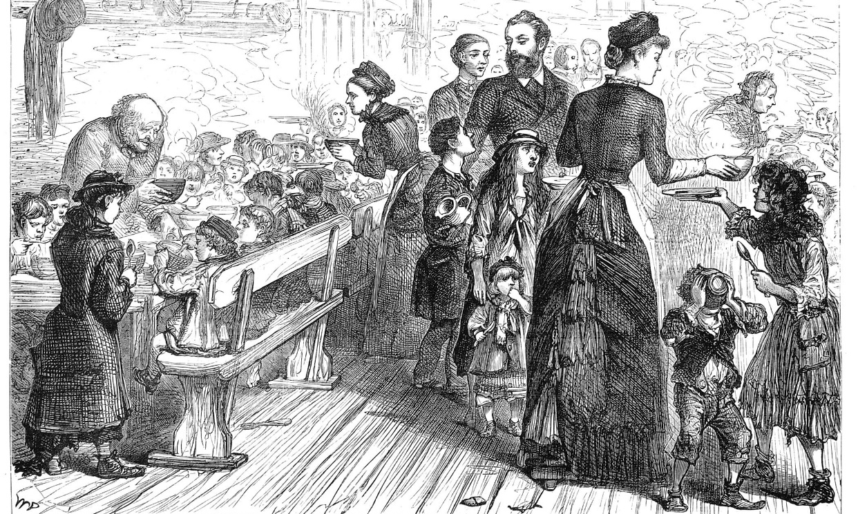
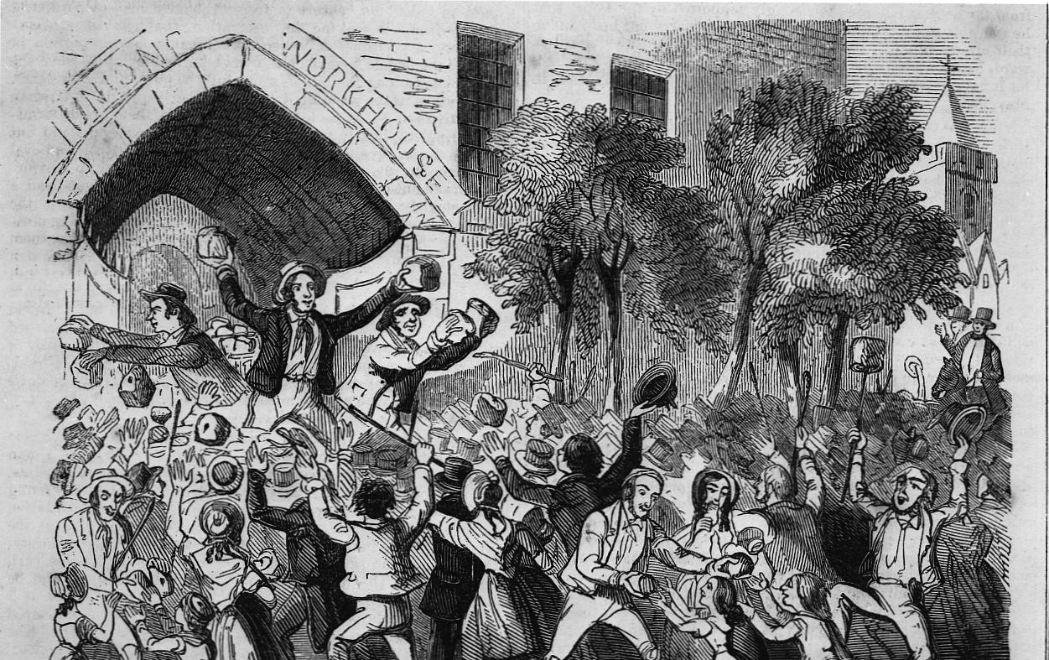
The food was tasteless and was the same day after day.
One Guardian of the Andover Workhouse discovered that some inmates working on bone crushing were actually eating some of the animal bones!
Food in the Workhouse

Slide 5
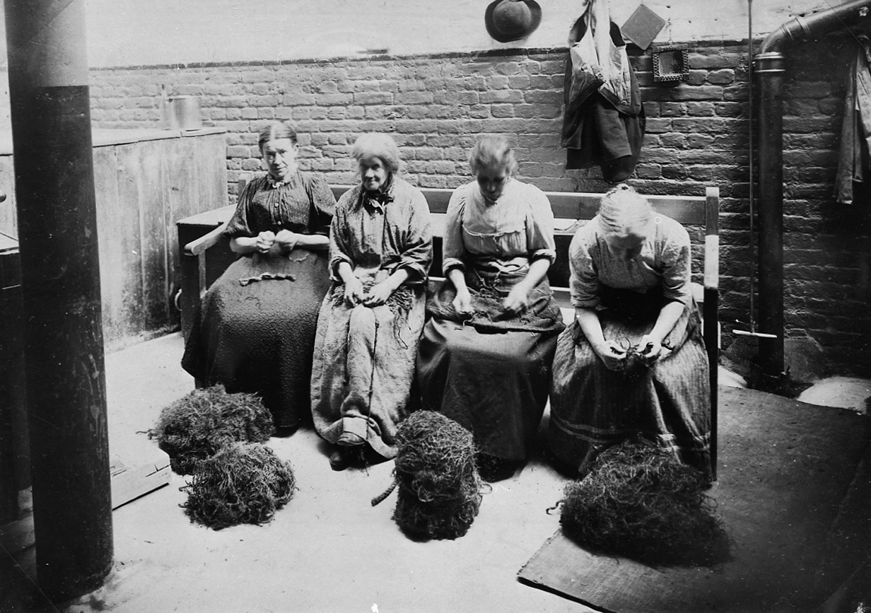
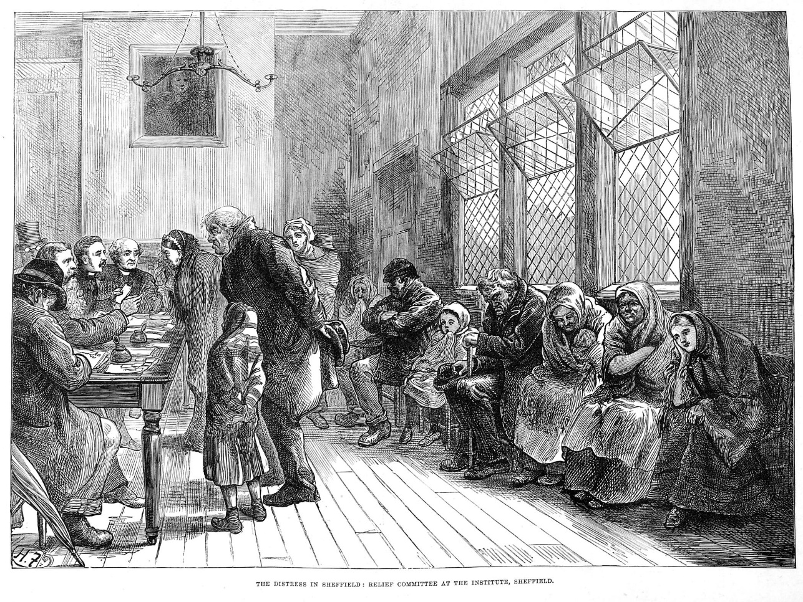
The poor were made to wear a uniform. This meant that everyone looked the same and everyone outside knew they were poor and lived in the workhouse. Some had to wear badges.
Upon entering the workhouse, the poor were stripped and bathed (under supervision).
Clothing in the Workhouse

Slide 6
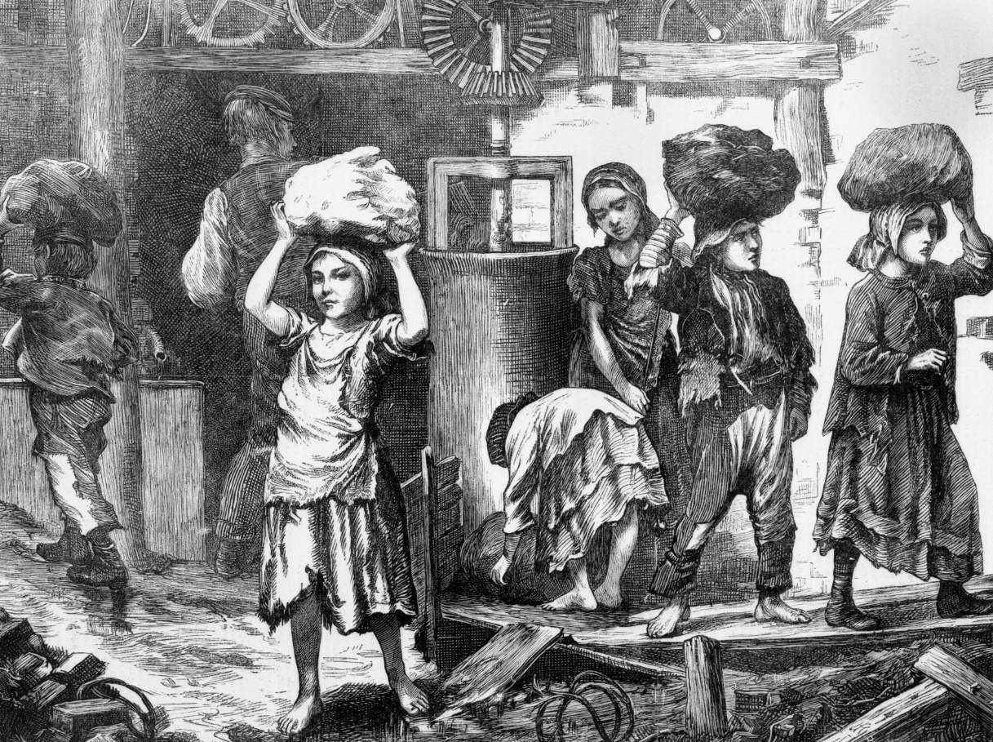
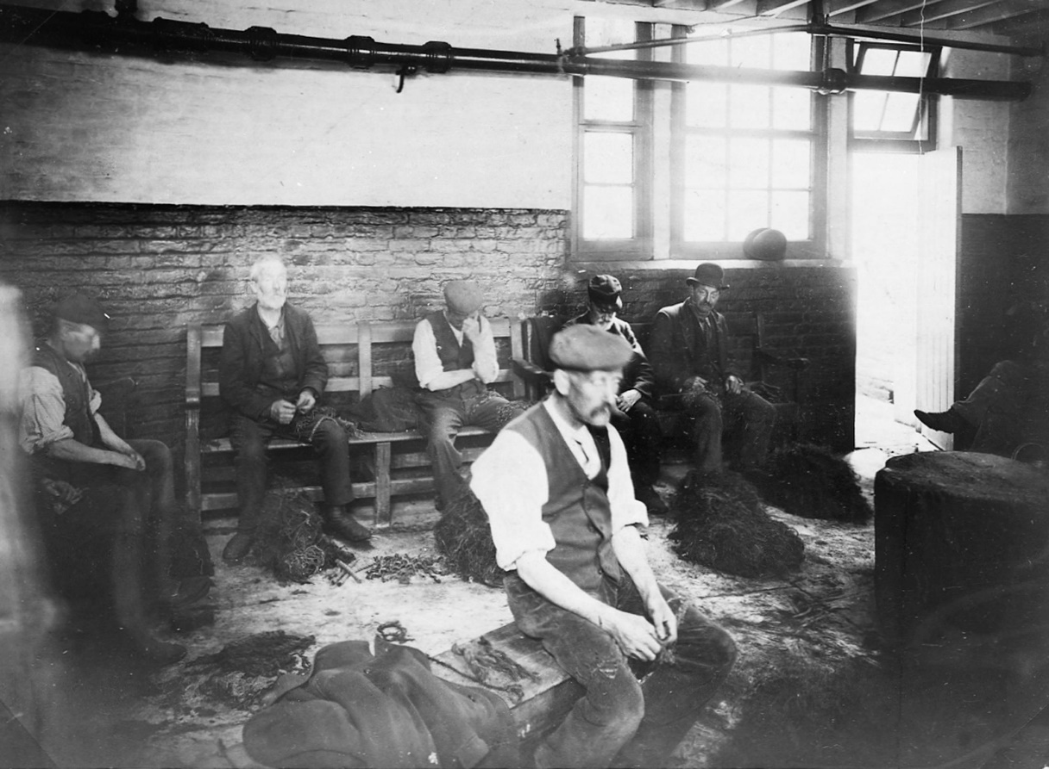
The young and old as well as men and women were made to work hard, often doing unpleasant jobs.
Children could also find themselves 'hired out' (sold) to work in factories or mines.
Stone breaking was a common and dangerous kind of work – often bits of stone could get in your eye, blinding you, or your hands could become damaged so that you were no longer able to use them properly.
The education the children received did not include the two most important skills of all, reading and writing, which were needed to get a good job.
Work in the Workhouse

Slide 7
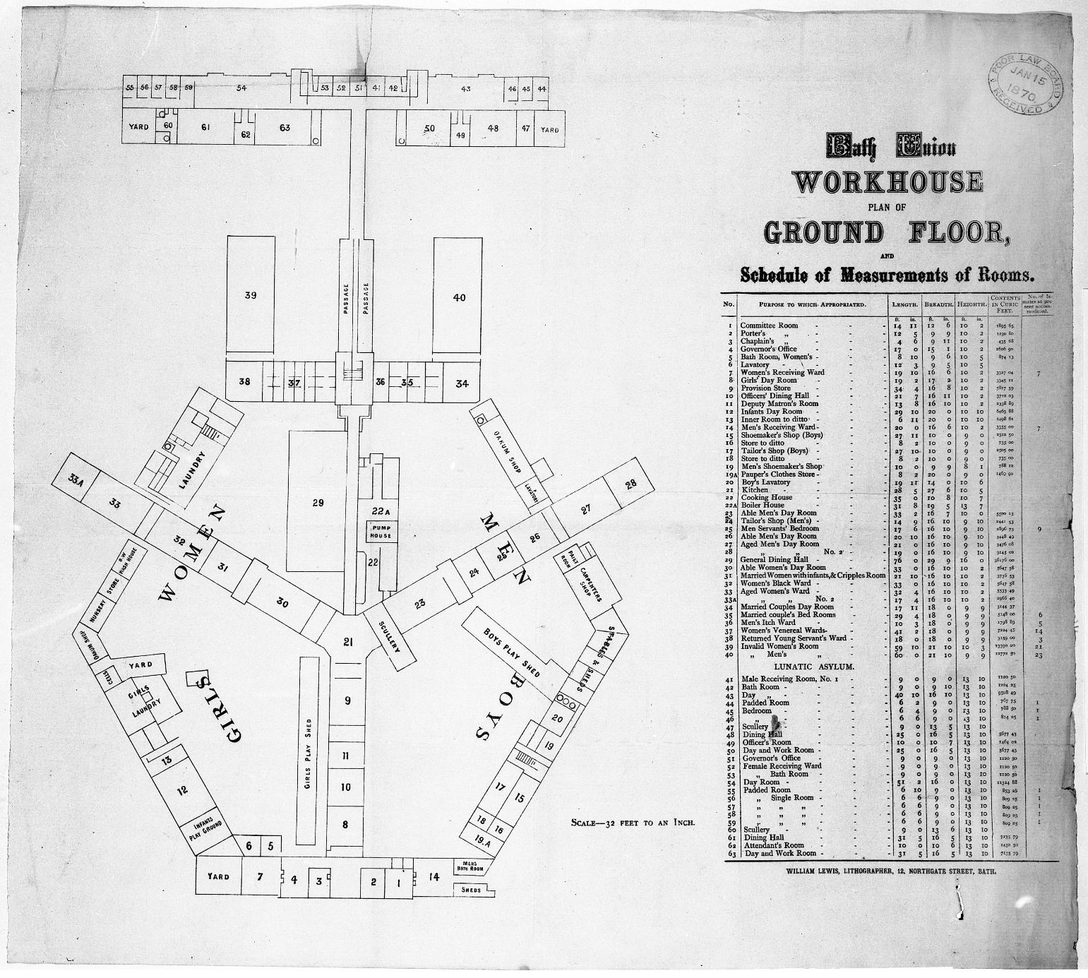
Women, children and men had different living and working areas in the workhouse, so families were split up.
To make things even worse they could be punished if they even tried to speak to one another!
Families in the Workhouse

Slide 8
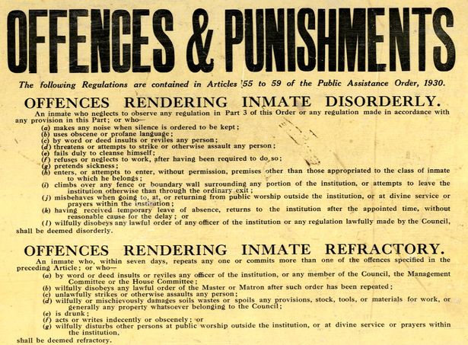
Punishment 1:
Only bread or potatoes for two days.
Punishment 2:
Solitary confinement for 24 hours.
Punishment 3:
Whipping
Punishment 4:
Hard labour
Punishment 5:
Prison
Punishment in the Workhouse
Reading Central Library reference C/PA/Z3/2/2

Slide 9
Topic | Details | Story Idea/Creative Sentence
Food
Clothing
Work
Families
Punishment

Slide 10
I have been most cruelly used here by the Master and almost crushed to death by him by him throwing me down and lying on me with his knees on my breast.
MH12/8978/15
…the most cruel treatment I have received. For nearly a fortnight I have been confined in a small cell in solitary confinement. I am sorry to say Gentlemen that I am suffering from a fractured thigh and locked in a solitary cell [from] which I am writing these lines. I must tell you the truth gentlemen that on my first admittance into this house, although being so ill I was placed in the stone yard and there kept until the medical man ordered otherwise. Now the master, to work out his own malicious designs, has kept me in a closed solitary cell and has kept me for three days on bread and water on account of my not being able to complete so heavy a task of work.
MH 12/6848
She was deprived of all her small [stock] of decent clothing so that when she went to see any of her former friends or those by whom she had been employed, she was obliged to wear that badge of indifference, the workhouse dress. She was also deprived of her nightdress and obliged to sleep without.
MH 12/6991
Besides locking me up as they did, they put soap in the provisions that dogs will not eat. If anyone put soap on the ground dogs will not take it. And to speak the truth the provisions are unwholesome throughout. And bad [with] never nothing but bad water to drink.
MH12/6708.
I am a man that has seen better times and cannot bear the pain of being separated from my children. A little relief would be the means of stopping breaking up my home.
MH12/5061
I am very unhappy I want to go to see my step mother Mrs Dunbar. They will not allow me to leave the place
MH12/7686

Slide 11
I have been most cruelly used here by the Master and almost crushed to death by him by him throwing me down and lying on me with his knees on my breast.
MH12/8978/15
…the most cruel treatment I have received. For nearly a fortnight I have been confined in a small cell in solitary confinement. I am sorry to say Gentlemen that I am suffering from a fractured thigh and locked in a solitary cell [from] which I am writing these lines. I must tell you the truth gentlemen that on my first admittance into this house, although being so ill I was placed in the stone yard and there kept until the medical man ordered otherwise. Now the master, to work out his own malicious designs, has kept me in a closed solitary cell and has kept me for three days on bread and water on account of my not being able to complete so heavy a task of work.
MH 12/6848
She was deprived of all her small [stock] of decent clothing so that when she went to see any of her former friends or those by whom she had been employed, she was obliged to wear that badge of indifference, the workhouse dress. She was also deprived of her nightdress and obliged to sleep without.
MH 12/6991
In front of you are some extracts from real workhouse letters!
Give each extract a title as if it was taken from a short story!
Tell your partner your ideas about the speaker!
I am a man that has seen better times and cannot bear the pain of being separated from my children. A little relief would be the means of stopping breaking up my home.
MH12/5061
Besides locking me up as they did, they put soap in the provisions that dogs will not eat. If anyone put soap on the ground dogs will not take it. And to speak the truth the provisions are unwholesome throughout. And bad [with] never nothing but bad water to drink.
MH12/6708.
I am very unhappy I want to go to see my step mother Mrs Dunbar. They will not allow me to leave the place
MH12/7686

Slide 12
Now it’s your turn to write a short story. You need to make the following decisions:
Which letter extract will inspire your story? (It can be more than one!)
First or third person.
Who is your character and where/when are they writing from?
What workhouse challenge will they face in particular?
What do they feel?
Is there a resolution or a cliffhanger? What emotion do they feel at the end?
How can you show this emotion rather than tell this emotion?
Which background details can you include to make your story vivid and realistic?
Which words can you use to show the time period?

Slide 13
Silent writing time. Remember your story should be between 400-500 words. This is about a page and a half (if you write roughly 7 words per line).
Draft it, check your SPAG and then count your words!

